Slide 1

Supply Chain Intelligence System
Predicting Late Deliveries Before They Happen
An end-to-end analytics and machine learning system for delivery risk
Author
Application
Mayank Singh
Diagnostic & Predictive ML Platform
End-to-End Delivery Risk Architecture · 2026
Notes:
Introduce the project: an end-to-end machine learning system built to detect delivery delays proactively rather than reacting after orders miss promised arrival dates.

Slide 2
More than half of orders arrive late, and we learn only after
54.70%
$2.1M
172,000+
Late delivery rate across the entire global fulfillment network
Operating profit directly at risk from delayed customer orders
Historical fulfillment orders analyzed across multi-year history
Quantify the problem
Locate bottlenecks
Predict at-risk orders
Deliver in one app
Isolate failure drivers across carrier shipping modes.
Arm planners with real-time operational interventions.
Measure network-wide delivery performance baseline.
Classify risk using strictly order-time parameters.
2 / 10
Notes:
Highlight the operational baseline: over 54% of orders miss promised delivery windows, putting 2.1 million dollars of profit at risk across 172k orders.

Slide 3
Five steps turn raw orders into a deployed predictor
01
02
03
Data cleaning and leakage removal
Frequency encoding
SMOTE class balancing
Handles high-cardinality categories compactly.
Stops the model ignoring the minority class.
Keeps the model honest.
04
05
RandomizedSearchCV tuning of a Random Forest
Streamlit deployment with a saved .pkl model
Puts predictions in planners' hands.
Finds strong settings efficiently.
3 / 10
Notes:
Walk through the technical lifecycle from data ingestion to user deployment. Emphasize that stripping target-leaking fields was critical for a realistic model.

Slide 4
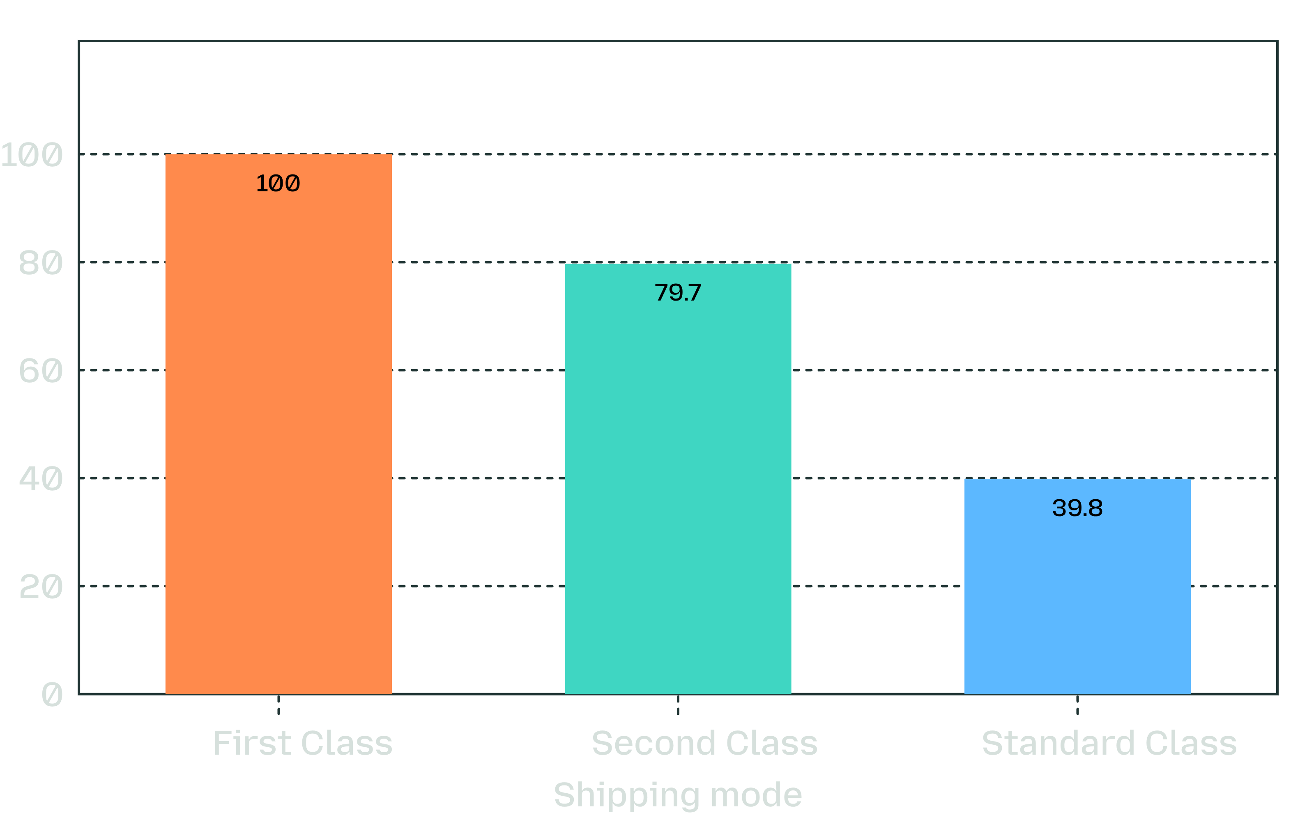
Shipping mode drives lateness
Late delivery rate (%) by fulfilled shipping mode across 172,000+ orders
Faster paid tiers miss promised dates most often.
First Class failed 100% of promised delivery targets, and Second Class missed 79.7%. Meanwhile, Same Day orders recorded no lateness.
This reveals unrealistic lead-time scheduling promises rather than pure carrier handling delays.
Figure 1. Empirical delivery failure by shipping mode.
4 / 10
Notes:
Explain the counter-intuitive finding: premium paid tiers experience catastrophic lateness rates. The root cause is unrealistic SLA commitments rather than transit speed.

Slide 5
Delays are short, systemic and costly
3 days
Monthly late rate
Holds at about 54.1% to 55.5%, so no strong seasonality. Points to process-driven bottlenecks, not peak-season capacity or random outliers.
90th percentile delay is only 3 days.
Profit at risk
Mean profit per order
$7.9M total profit; $2.1M profit at risk; $21.97 average order profit.
Falls from about $23 (2 days early) to about $19.7 (3 days late).
5 / 10
Notes:
Demonstrate that delays are systemic, not seasonal. Highlight how delay duration directly erodes unit profit margins from twenty-three dollars down to nineteen seventy.

Slide 6
The model catches about 3 in 4 late orders
74%
79%
75%
Overall accuracy on 34,553 held-out test orders
Precision on late orders: 79 of 100 flagged are truly late
Recall on late orders: flags 3 in 4 delayed deliveries
Fulfillment status | Precision | Recall | F1-Score
On-Time Orders | 0.68 | 0.73 | 0.70
Late Delivery Risk | 0.79 | 0.75 | 0.77
Beats a naive majority-class baseline by 17 percentage points.
Dispatch teams adjust classification probability thresholds based on expedited freight costs versus SLA penalty liabilities.
Evaluated on 34,553 held-out test orders (57.3% base late rate).
6 / 10
Notes:
Present the model performance metrics. The Random Forest achieves 79% precision and 75% recall, outperforming simple majority class guessing by 17 points.

Slide 7
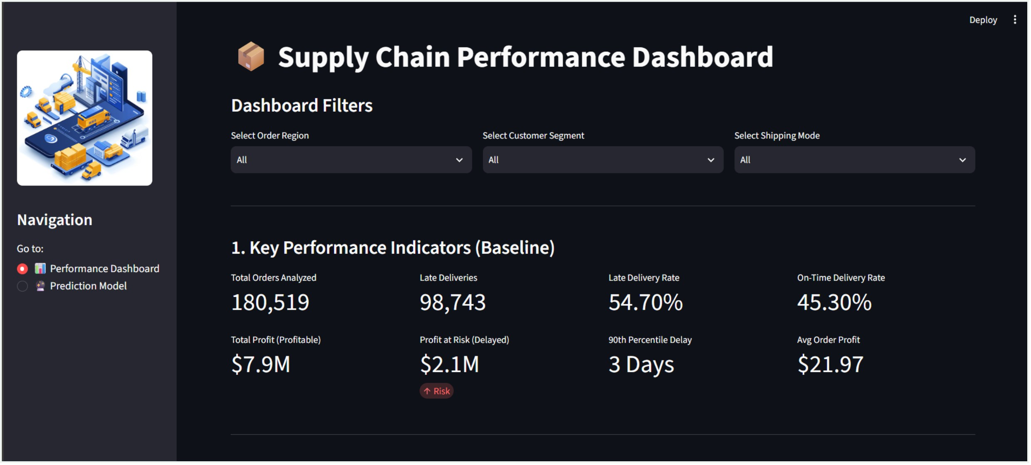
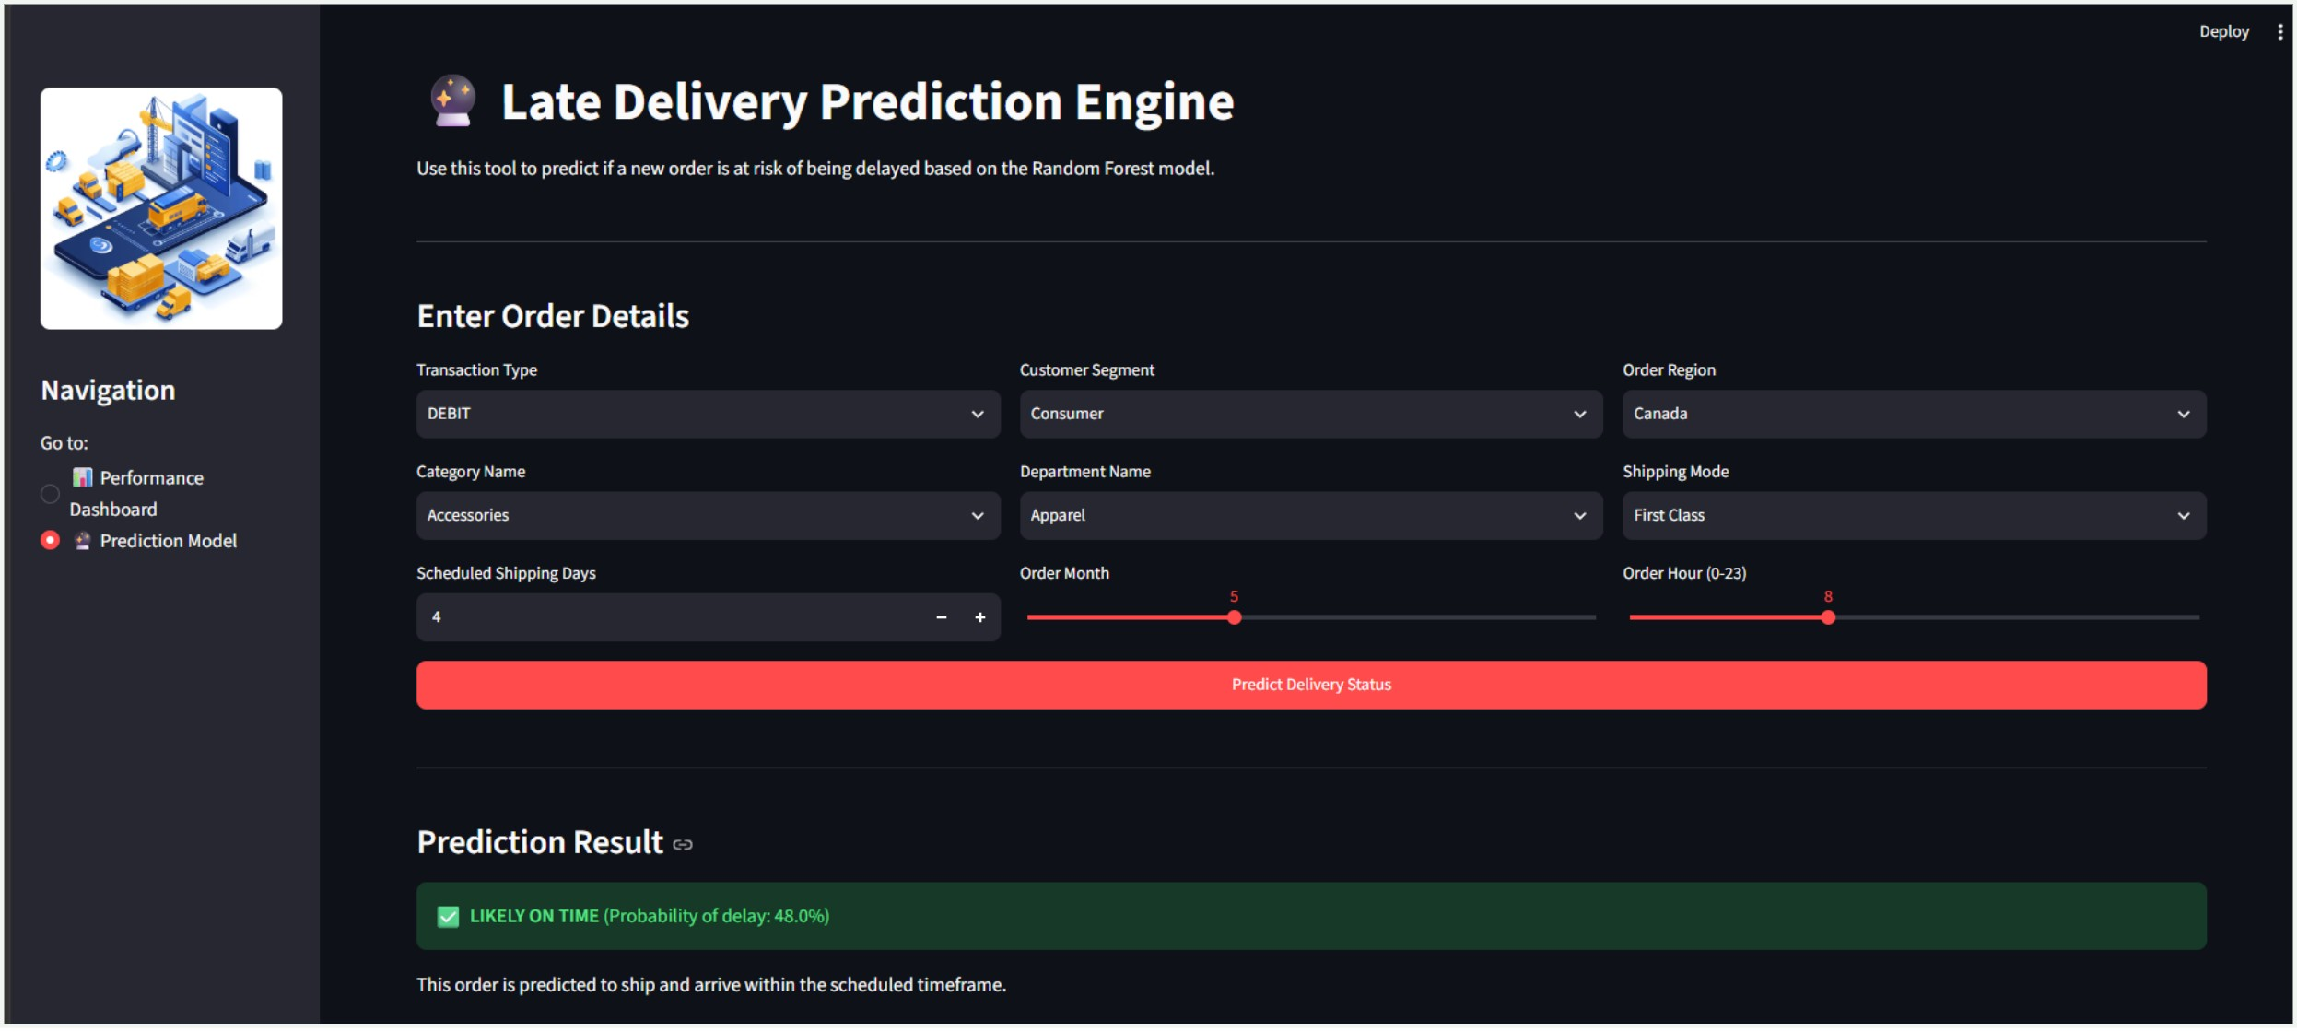
One app, two pages: diagnose and predict
a · Performance Dashboard
b · Prediction Engine
KPIs, profit vs delivery time, bottleneck detection, monthly trends and strategic insights; filters for region, segment and shipping mode.
Enter nine order details to get delay probability, an at-risk or on-time verdict, and fulfillment recommendations.
Architecture: Order data and training notebook → saved model → Streamlit app serving both pages → leaders and planners.
7 / 10
Notes:
Demonstrate how machine learning results are deployed into daily operations. Page 1 delivers high-level visibility; Page 2 provides order-level predictive scoring.

Slide 8
Pilot first, then scale across the network
Four disciplined deployment phases spanning retail, manufacturing, and third-party logistics.
01
02
03
04
Phase 1: Diagnose
Phase 2: Pilot
Phase 3: Scale
Phase 4: Optimize
Audit First and Second Class scheduling lead times; reconcile promises with carrier transit realities.
Deploy the at-risk flag with a single fulfillment pod; track alert response compliance and rerouting costs.
Roll out web portal across regional distribution hubs; tie predictions into weekly OTIF operational reviews.
Automate carrier switching logic; benchmark quarterly reduction in profit at risk against baseline targets.
Execution targets: On-Time Delivery (OTD) · SLA Compliance · On-Time In-Full (OTIF)
8 / 10
Notes:
Outline the four-stage rollout strategy. Emphasize starting with a single fulfillment team to prove ROI before expanding network-wide.

Slide 9






Known limits point to a clear next-step roadmap
Model & Data Limitations
Engineering Next Steps
Single dataset scope
SHAP explainability
Trained on one source environment; distribution shifts need retraining.
Surface order-level feature contributions to explain why specific shipments flag as high-risk.
Synthetic SMOTE samples
Contextual feature enrichment
Oversampling balances classes, but performance must be continually audited on live data.
Integrate real-time carrier congestion, weather events, and warehouse backlog signals.
Probabilistic outputs
Automated retraining & REST API
Confidence scores estimate likelihood, not deterministic arrival certainty.
Implement scheduled model drift re-fitting and programmatic ERP integration.
9 / 10
Notes:
Address methodological boundaries with transparency while presenting concrete engineering solutions: SHAP values, external data signals, and automated pipeline integration.

Slide 10
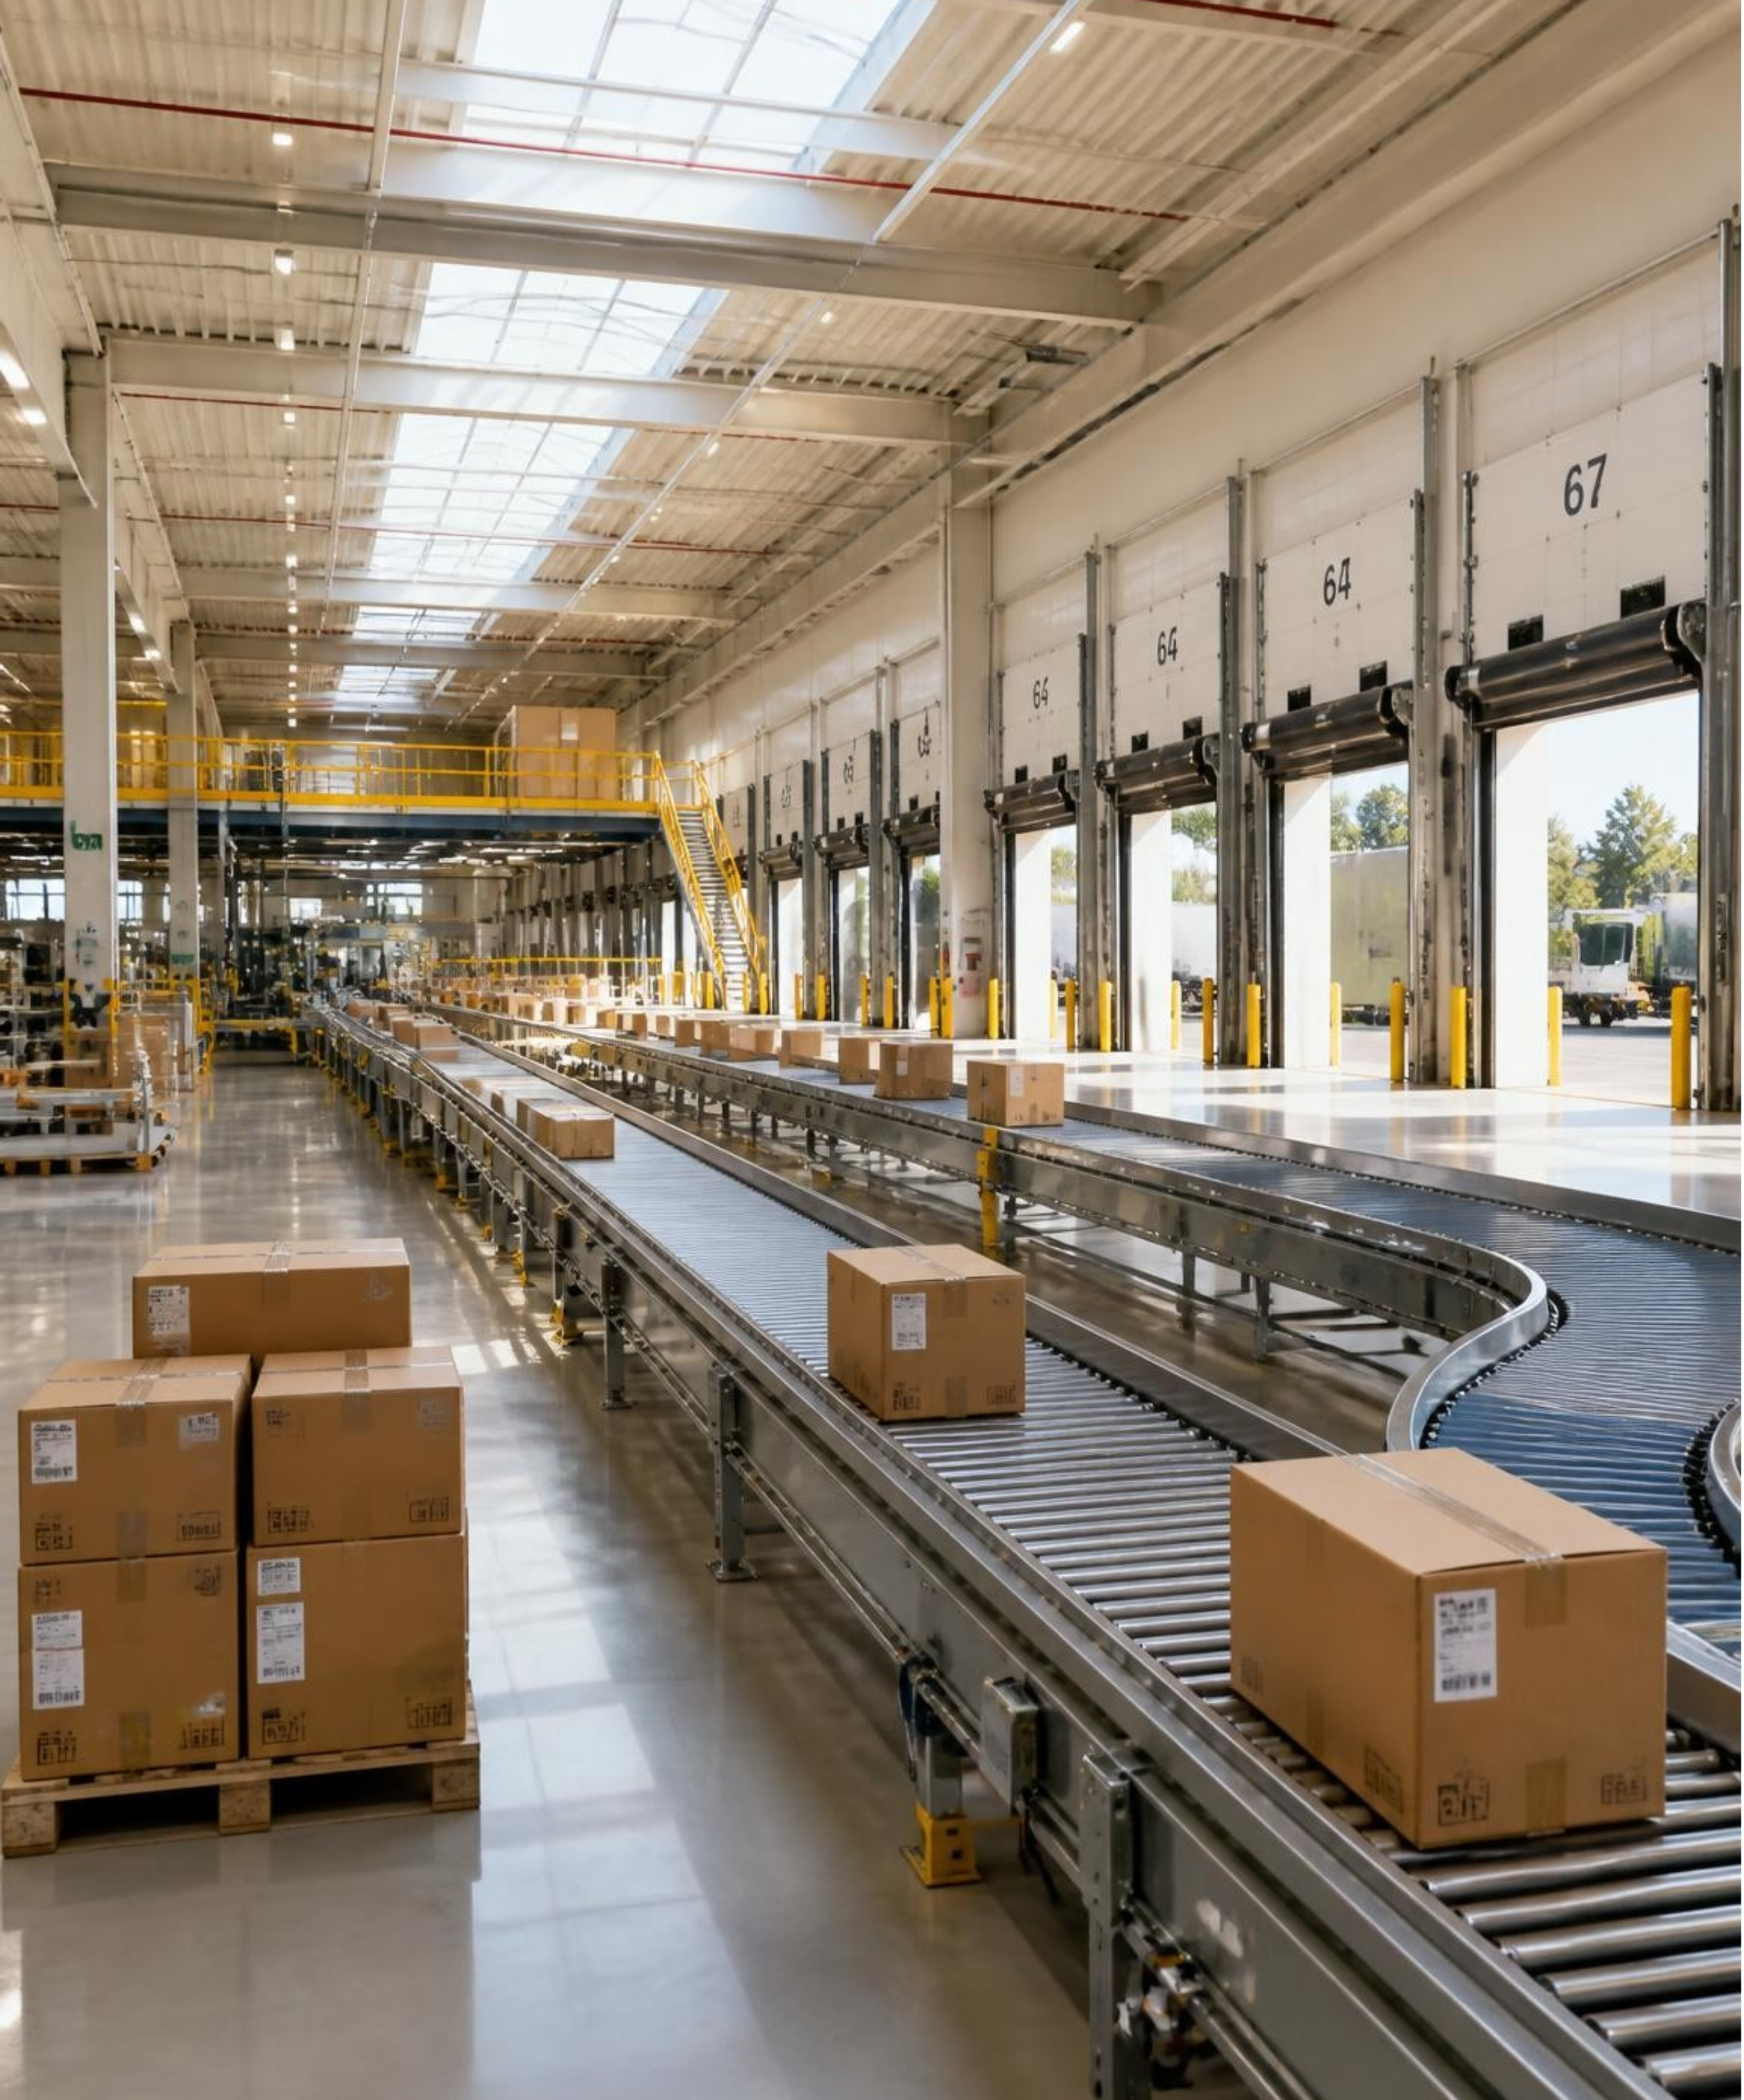
Thank you / Questions
https://supplychainproject-ppfvwhuketoasrjbsmqcsl.streamlit.app/
https://github.com/mayanksingh2108
Notes:
Conclude the presentation and invite questions from the audience, sharing direct access links to the live Streamlit application and GitHub code repository.

